Slide 1
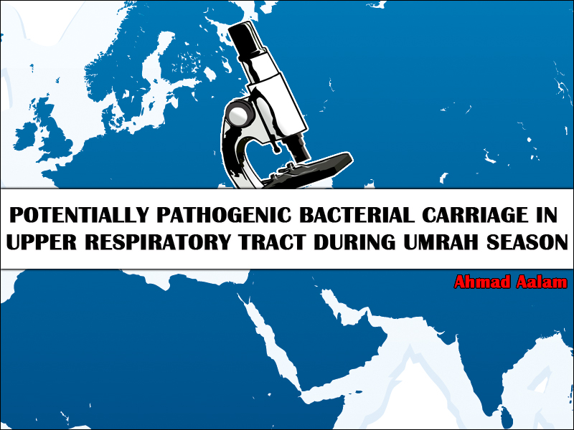

Slide 2

Background
Aims
Methodology
Results
Conclusions
Future Work
Acknowledgment

Slide 3


Slide 4
Background (I)
What is Ummrah?
-Millions of Worldwide Muslims come each year to the holy city of Makkah, Saudi Arabia.
-Between February to end of September.

Slide 5
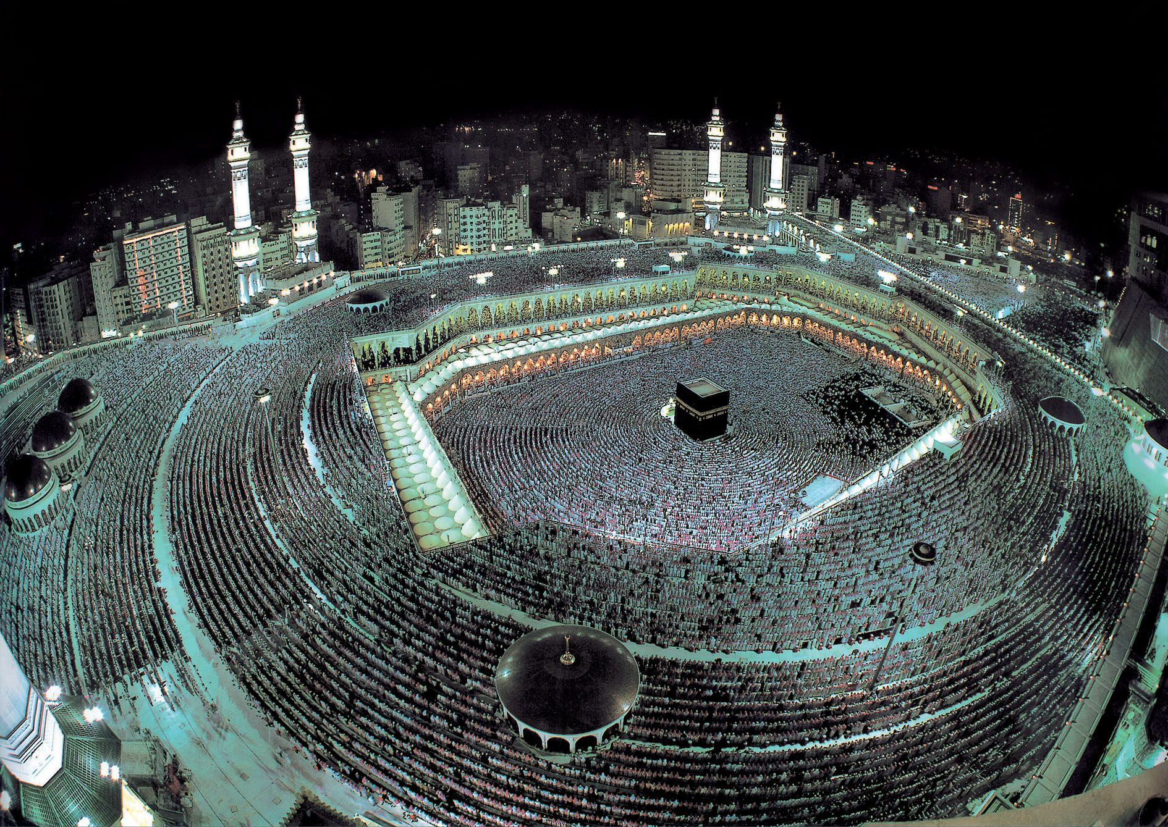
Background

Slide 6
Background (II)
Overcrowded condition within a confined area for a defined period of time,
public health challenges, and health risks are greatly increased with potential for both local and international consequences

Slide 7
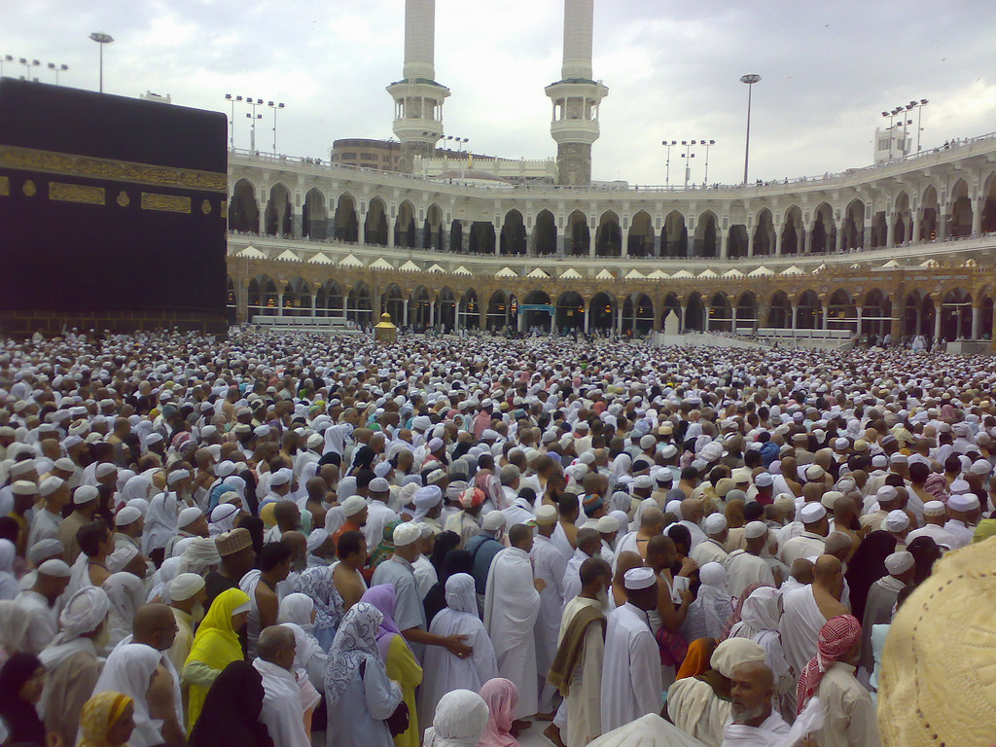

Slide 8
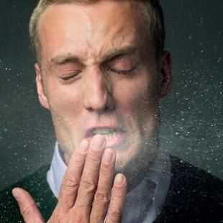
Background (III)
Respiratory tract and meningitis infections correlated with such a crowded condition due to its ease of transmission (air droplets)

Slide 9
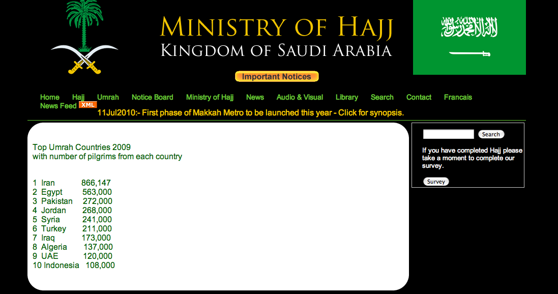
2,959,147 Umrah Visitors for 2009

Slide 10
Background (IV)
Nasopharynx and nares are densely colonized by a variety of microorganisms including Potentially Pathogenic Bacteria (PPB) mainly:
Staphylococcus aureus,
Streptococcus pneumoniae,
Streptococcus pyogenes,
Neisseria meningitidis,
Moraxella catarrhalis
Haemophilus influenzae.

Slide 11
Background (V)
Studies have shown that colonization with PPB is a major contributing factor for respiratory and extra-respiratory infections including pneumonia, sepsis, and meningitis in PPB carriers as well as their closed contacts .

Slide 12


Slide 13

1
prevalence of PPB among Umrah visitors from different ethnic groups before and after performing Umrah

Slide 14
2
Colonization (PPB) in different ethnic groups, to find out any significant correlation between carriage rate and ethnic
group

Slide 15
3
The antibiotics resistance patterns of PPB Isolates before and after performing Umrah

Slide 16


Slide 17
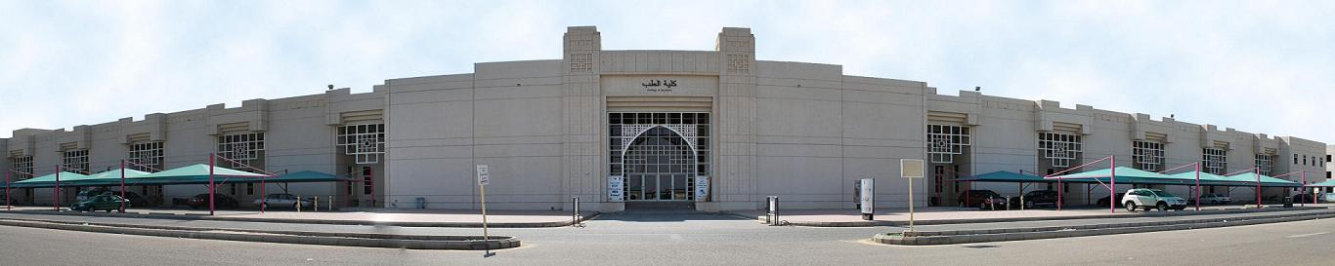
1. Subject of the study (1)
February to September 2009 in the Microbiology research Laboratory, Faculty of Medicine , Umm al-Qura University.

Slide 18
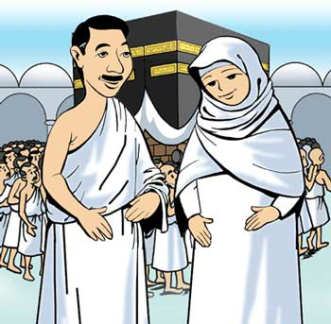
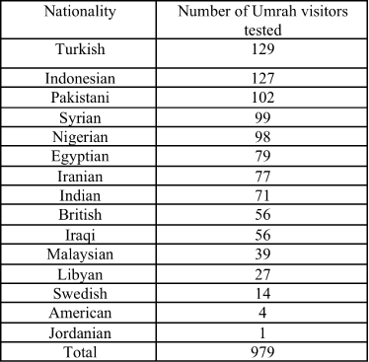
1. Subject of the study (II)
979 Umrah visitors from different nationalities including

Slide 19
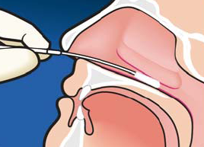
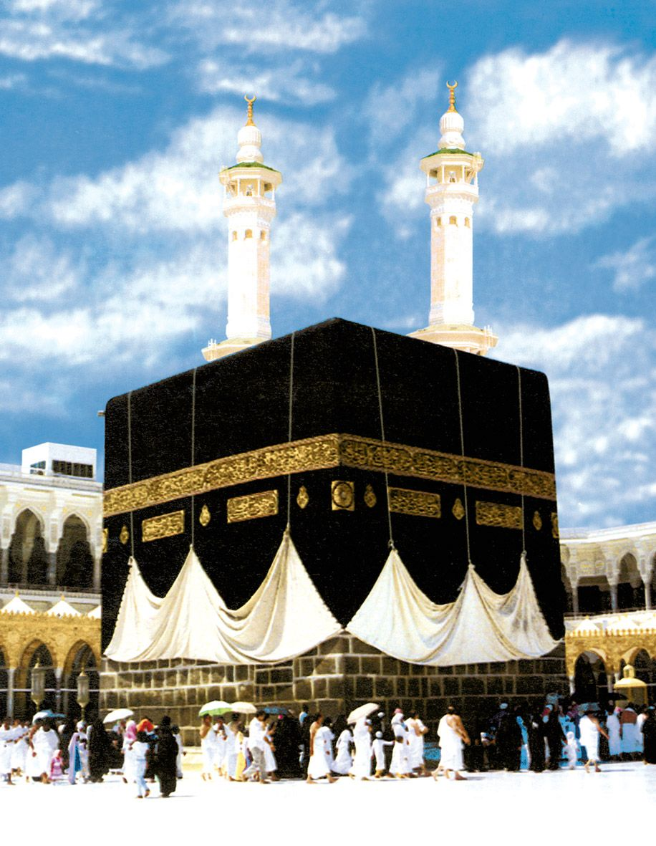
2. Collection of specimens
5874 Samples were collected from Throat, Nasal and Sinuses
3x
3x

Slide 20
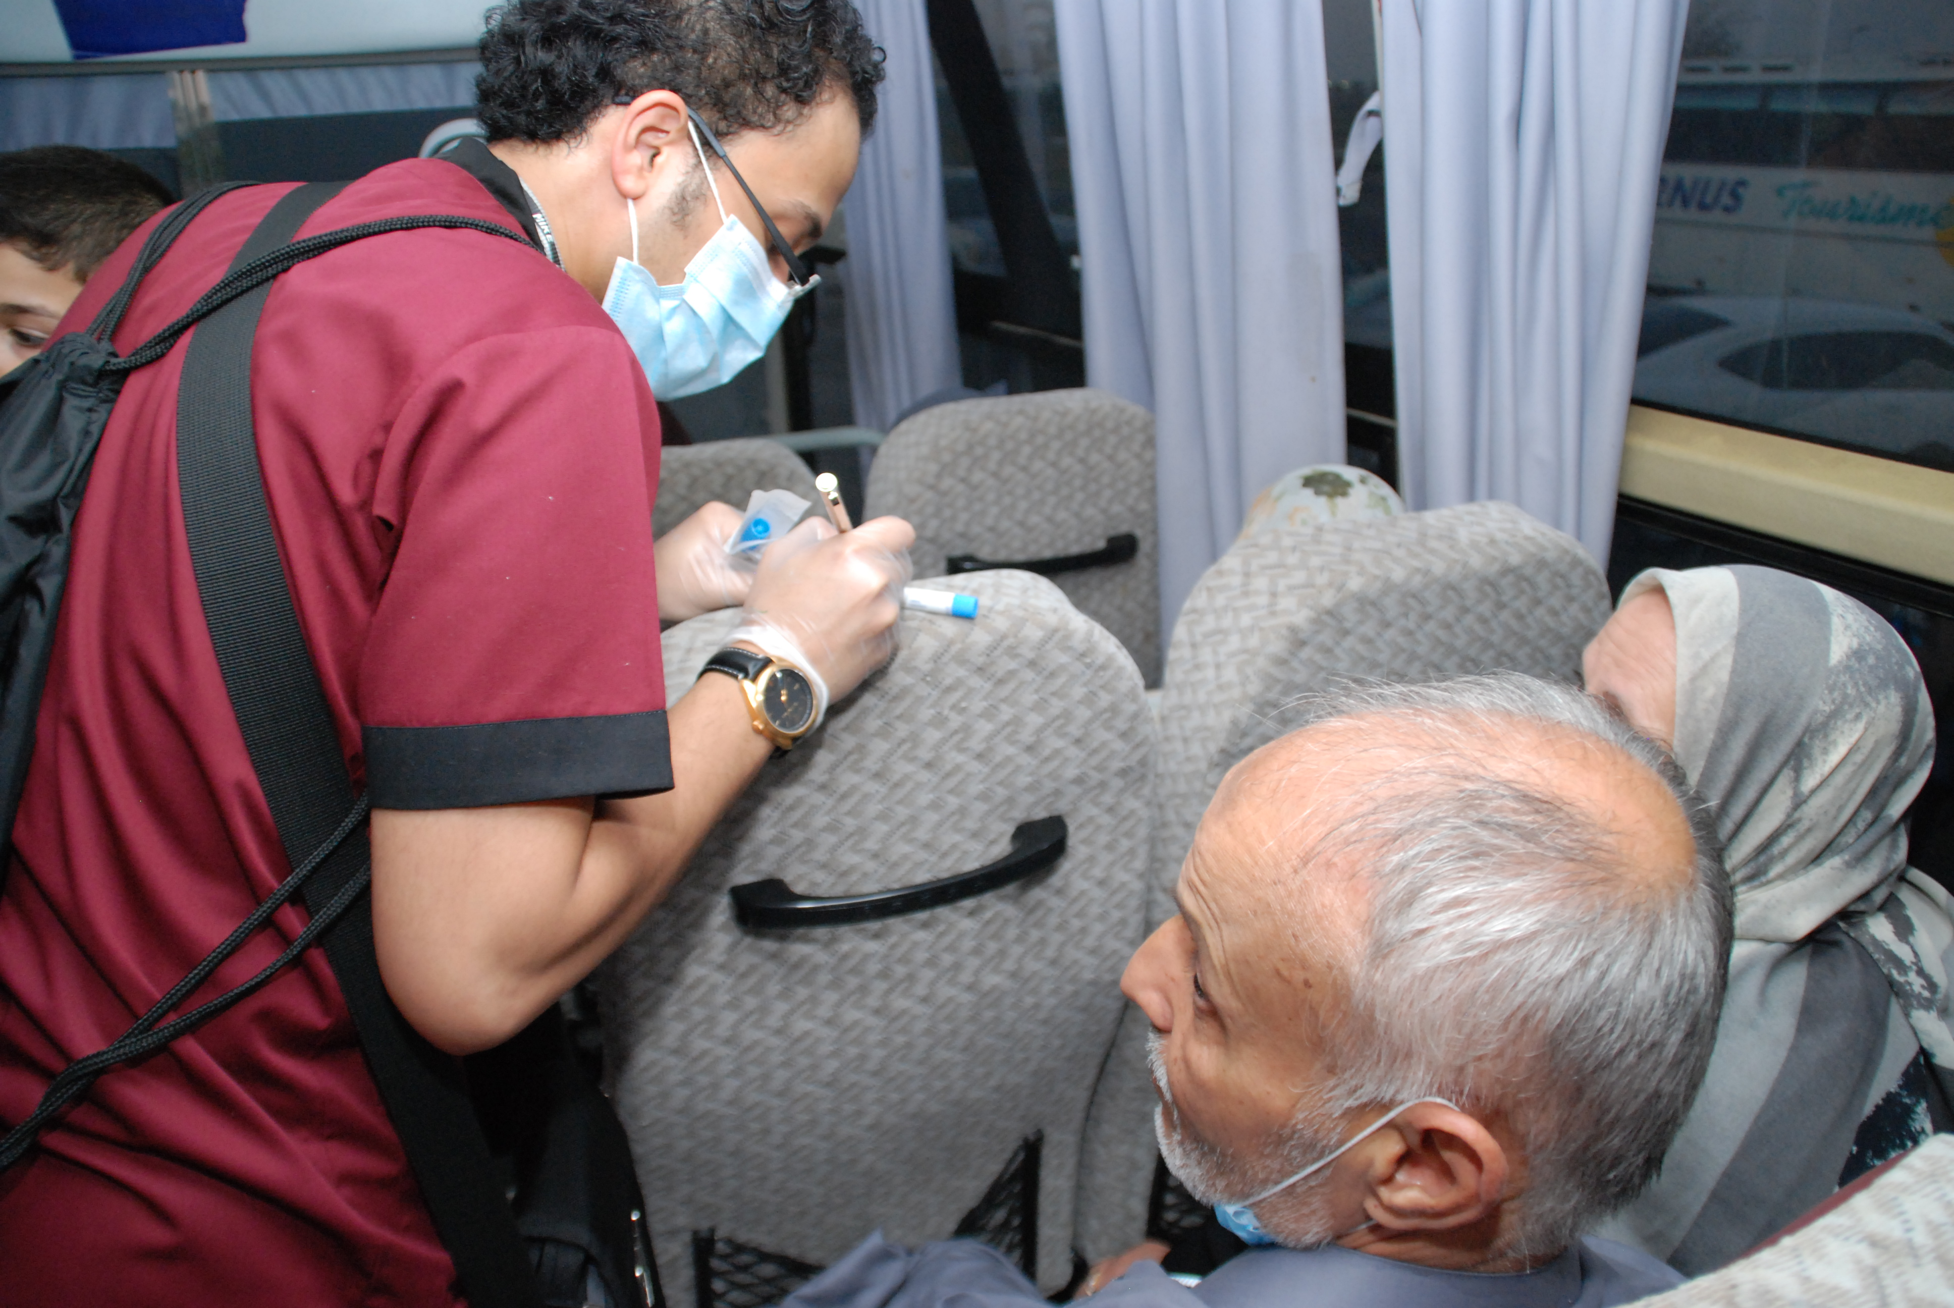

Slide 21
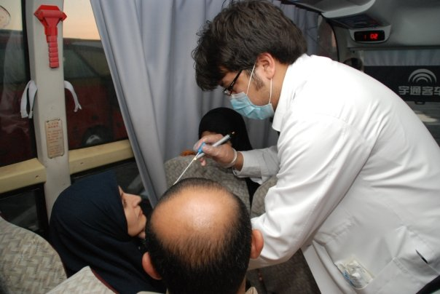

Slide 22
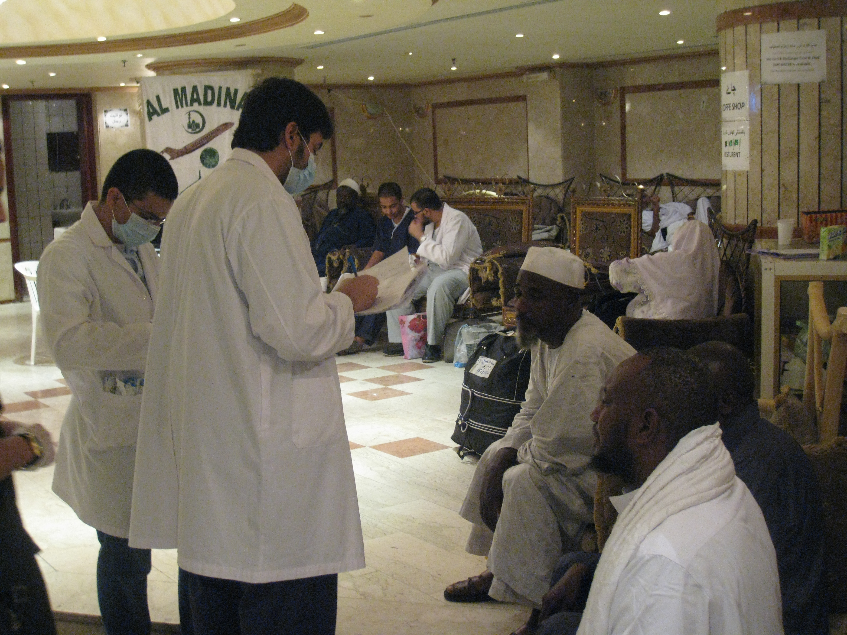

Slide 23
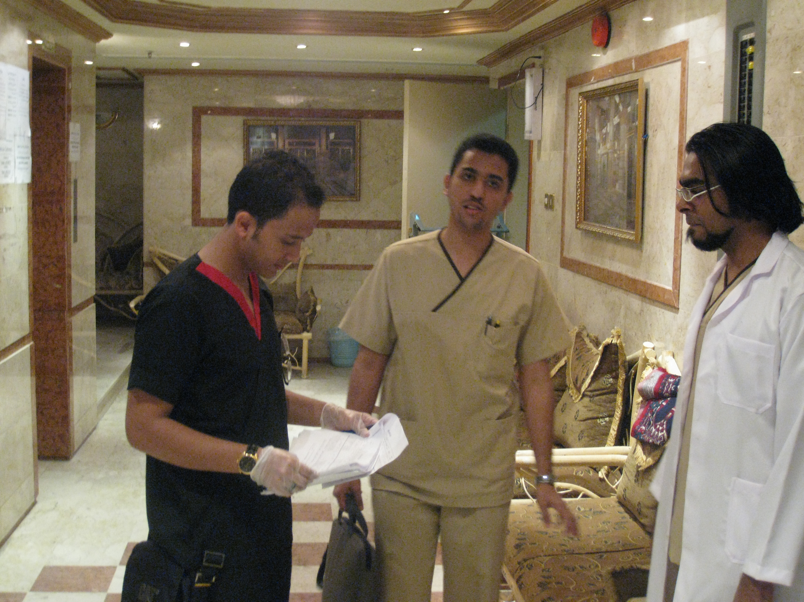

Slide 24

3. Transportation of the specimens
All Samples were collected on Amies transport swabs media.
Transported to the Microbiology research laboratory Immediately, and saved in a heat isolated bags.

Slide 25
4. Cultivation of specimens
Sample Type | Type Of Media | Cultivation Condition
Throat | Columbia blood agar | 37Cº under aerobic conditions
Nasal | Mannitol salt agar | 37Cº under aerobic conditions
Nasopharyngeal | Chocolate agar Modified Thayer Martin agar (MTM) | 37Cº in CO₂ incubator

Slide 26
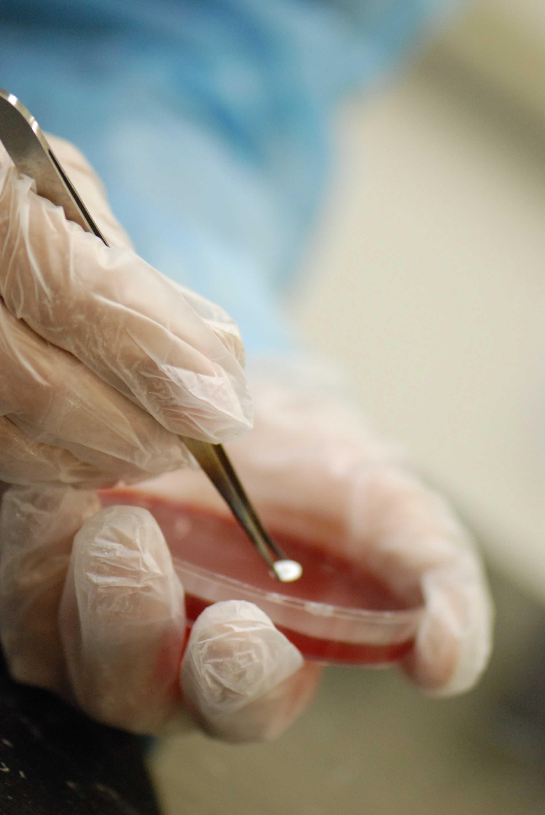

Slide 27
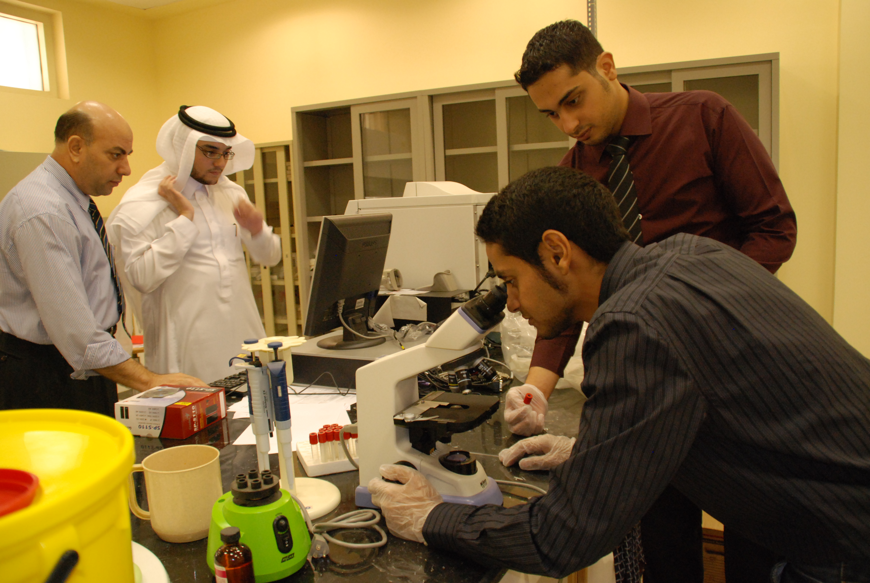

Slide 28
5. Isolation and Identification of bacteria
All bacteria were isolated and identified according to the conventional microbiological methods.
In addition all PPB isolates were confirmed using VITEK® II Machine.

Slide 29
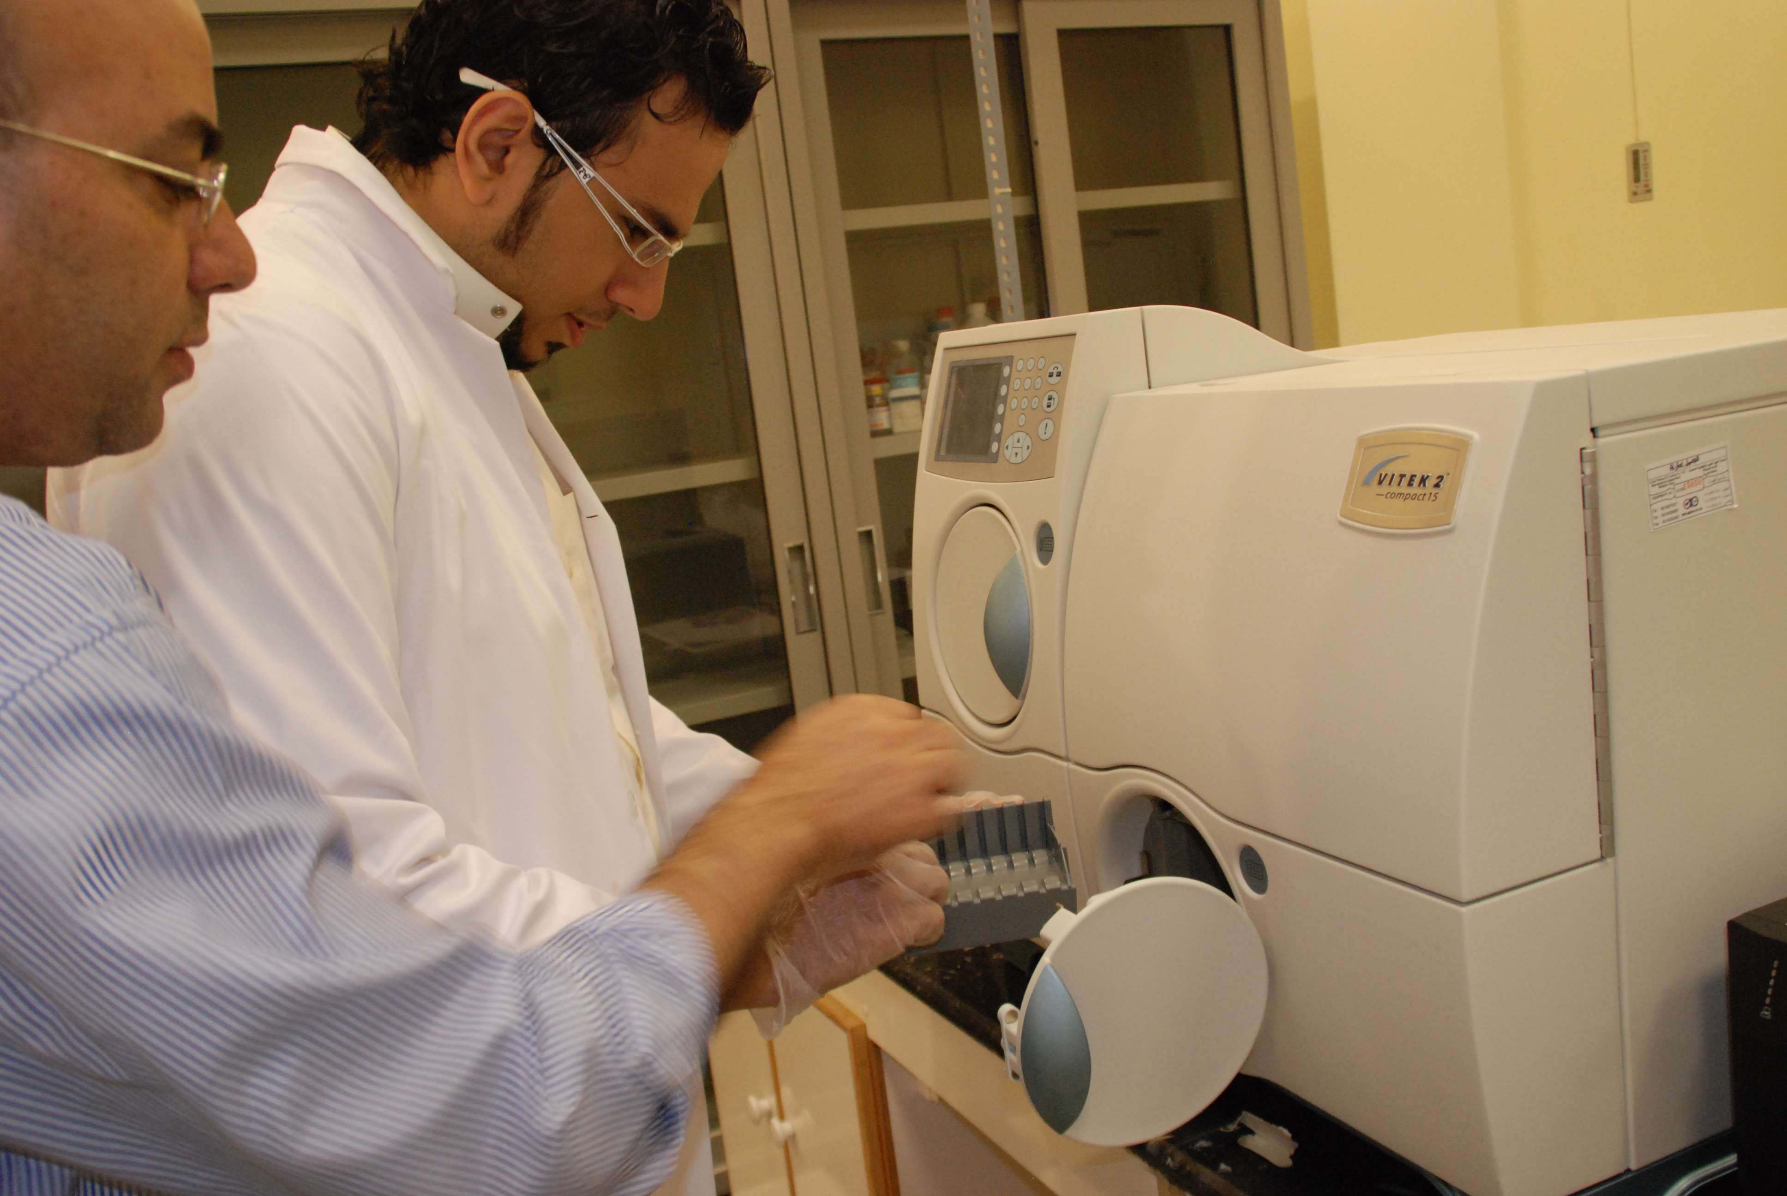
VITEK® II

Slide 30
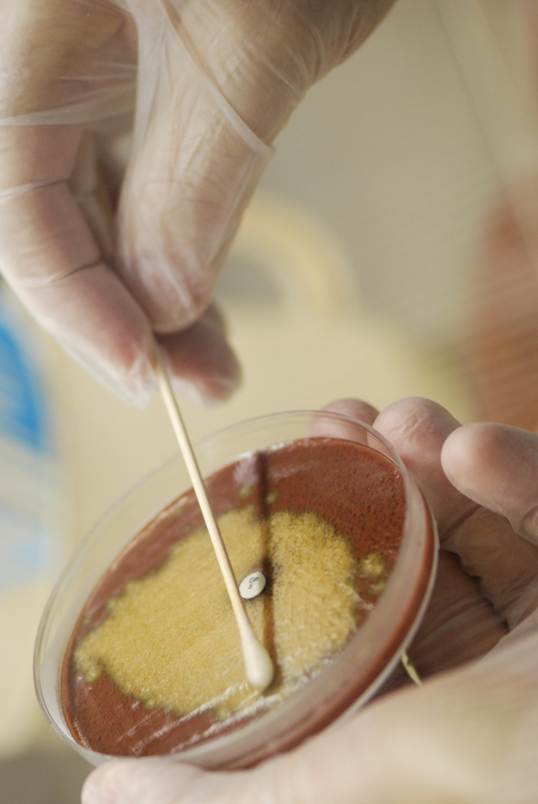

Slide 31
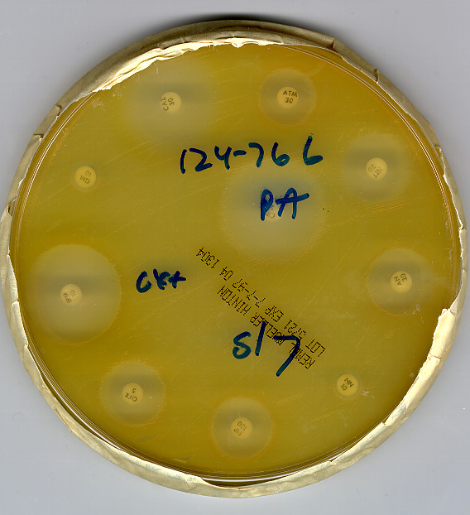
6. Antimicrobial Susceptibility Testing
Antimicrobial susceptibility testing were performed on all isolates using disc diffusion method and VITEK® II machine

Slide 32

7. Data Analysis
All data were statistically analyzed using Graphpad Prism III® software. P-values less than 0.05 was considered significant.

Slide 33


Slide 34
Overall Prevalence
Out of 5874 samples 920 (15.7%) positive for (PPB).
P-value of 0.0001

Slide 36
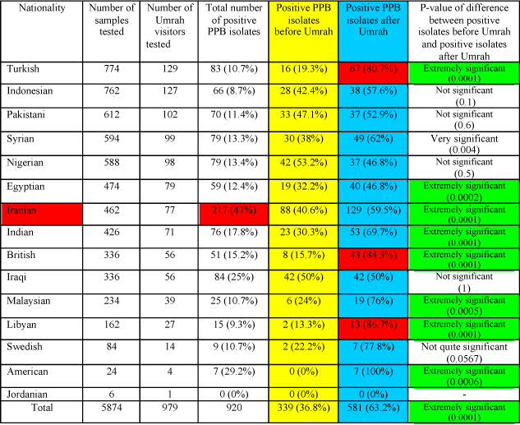
Table 2. Overall prevalence of PPB isolated from different nationalities of the Umrah visitors during the Umrah season

Slide 37
Table 3. Antimicrobial Susceptbility of Staph. Aureus

Slide 38


Slide 39

Conclusion (I)
15.7%
  1) A 15.7% (920/5874) carriage rate
  PPB among the Umrah visitors was found.

Slide 40

Conclusion (II)
  2) The Iranian Umrah visitors were the
  largest ethnic group carries PPB. The
  percentage of PPB on them was 47%,
  (217/462).

Slide 41
Conclusion (III)
  3) Performing Umrah increases the
  carriage rate of PPB, since Out of 920
  positive samples collected from the Umrah
  visitors in this study, 339 (36.8%) were positive
  before Umrah and 581 (63.2%) were
  positive after Umrah.

Slide 42
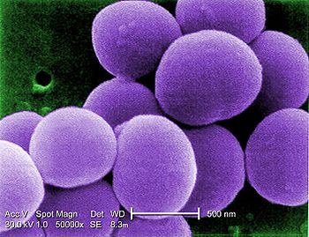
Conclusion (IV)
  4) Carriage Rate:
  Staphylococcus (42.4%),
  Moraxella catarrhalis (35.4%),
  Neisseria meningitidis (20.7%),

Slide 43


Slide 44
Future Works
  Still finishing up the analysis of the antibiotic susceptibility
  Still waiting for the serotyping kits for:
  *Streptococcus pneumoniae
  *Neisseria meningitidis..
  - Now we are analyzing data of Hajj season.

Slide 45


Slide 46
References
Qureshi H, Gessner B, Leboulleux D, Hasan H, Alam S, Moulton L. The
Incidence of vaccine preventable influnenza-like illness and medication use among
Pakistani pilgrims to the Hajj in Saudi Arabia. Vaccine. 2000;18.
Wilder-Smith A, Memish Z. Meningococcal disease and travel Int. J. Antimicrobial
Agents. 2003;21:102-6.
Cardozo D, Nascimento-Carvalho C, Souza F, Silva N. Nasopharyngeal
colonization and penicillin resistance among Pneumococcal strains: a worldwide 2004
update. The Brazilian Journal of Infectious Diseases. 2006;10(4):293-303.
Kadioglu A, Weiser J, Paton J, Andrew P. The role of Streptococcus
Pneumoniae virulence factors in host respiratory colonization and disease. Nature Reviews. 2008;6:288-99.
Peacock S, de Silva I, Lowy F. What determines nasal carriage of
Staphylococcus aureus? Trends Microbiol. 2001;9(12):605-10.
Musher DM. Streptococcus pneumoniae. In: Mandell GL, Bennett JE, Dolin R
(eds). Principles and Practice of Infectious Diseases. 6 ed. New York, NY: Elsevier
Churchill Livingstone, 2005:2392-407.
Tenover F, Gaynes R. The epidemiology of Staphylococcus infection. In:
Fischetti V, Novick R, Ferretti J, Portnoy D, Rood J (eds). Gram-positive pathogens
Washington American Society for Microbiology, 2000:414 – 21.
Ruoff KL, Whiley RA, Beighton D. Streptococcus. In: Murray PR, Baron EJ,
Jorgensen JH, Pfaller MA, Yolken RH (eds). Manual of Clinical Microbiology. 8 ed.
Volume 1. Washington, D.C: ASM Press, 2003.
Melles D, Bogaet D, Gorkink R, et al. Nasopharyngeal co-colonization with
Staphylococcus aureus and Streptococcus pneumoniae in children is bacterial
genotype independent. Microbiology. 2007;153:686-92.
Y. Perianal streptococcal dermatitis in children. Eur J

Slide 47


Slide 48
Acknowledgment
-Center of Research Excellence in Hajj and Omrah.
-The Custodian of the Two Holy Mosques Institute of Hajj researches.
-My supervisors:
Johargy Ayman, Asghar Atif, Momenah Aiman, Alherabi Ameen, Mashat Bassam, Al-Saeed Ashraf, Al-Saeed Hamdy.
-My Colleagues from Faculty of medicine and Medical Since.
-And technicians.

Slide 49


