Slide 1

Done By: Dr.Ahmad A. Aalam

Slide 2


Slide 3


Slide 4
Operate ??!!
Yes if
1-Hemodynamically unstable,
2-Diffuse abdominal tenderness, or
3-Signs of peritonitis develop.
If there is an unexplained drop in blood pressure or hematocrit, further investigation is warranted.

Slide 5
IF NOT???

Slide 6
1 ) Physical examination
2 ) Use of computed tomography
3 ) Morbidity of nontherapeutic laparotomy
4 ) Duration of observation
5 ) Visceral or omental evisceration
6 ) Right upper quadrant penetrating injury
7 ) Penetrating renal trauma
8 ) Investigation for diaphragm injury

Slide 7
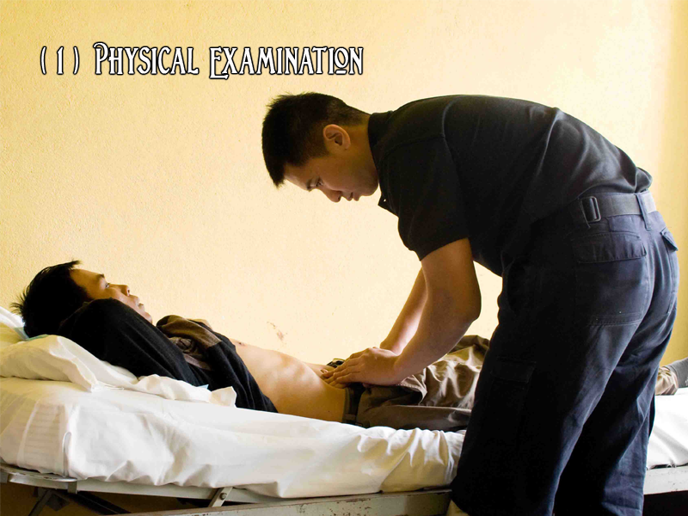

Slide 8
Physical Exam.
-Physical examination is reliable in detecting significant injuries after penetrating trauma.
-Serial examinations should be performed

Slide 9
Physical Exam.
-Patients requiring delayed laparotomy will develop abdominal signs LATER.
-WHAT ARE THOSE SIGNS YOU ARE AFRAID OF??!!

Slide 10
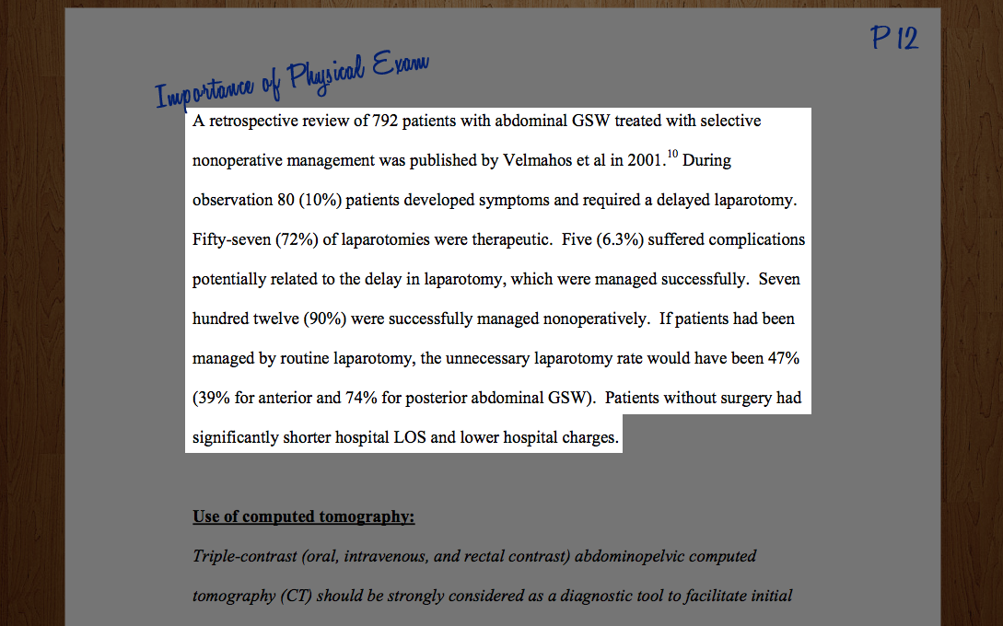

Slide 11
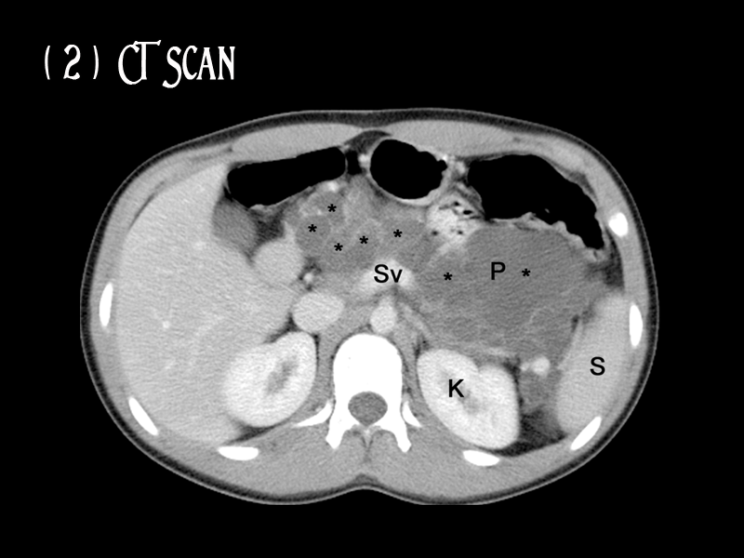

Slide 12
CT Scan
Triple-contrast (oral, intravenous, and rectal contrast) abdominopelvic CT should be strongly considered as a diagnostic tool.

Slide 13
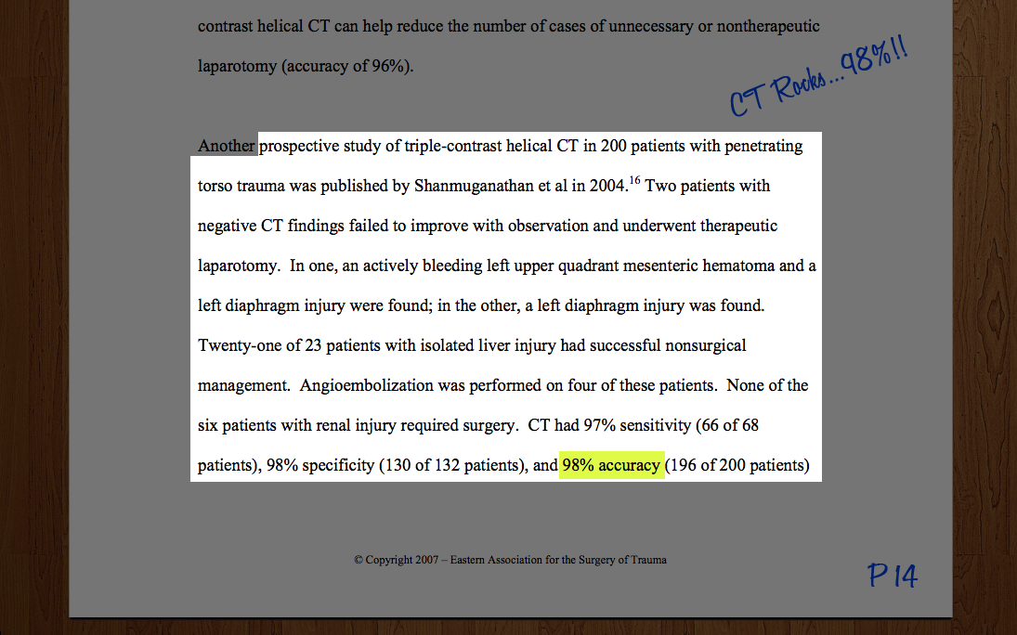

Slide 14


Slide 15
Morbidity of nontherapeutic laparotomy
Mandatory laparotomy for penetrating abdominal trauma detects some unexpected injuries earlier and more accurately,
But
Results in

Slide 16
Morbidity of nontherapeutic laparotomy
-A higher nontherapeutic laparotomy rate.
-longer hospital stays.
-Increased hospital costs.

Slide 17
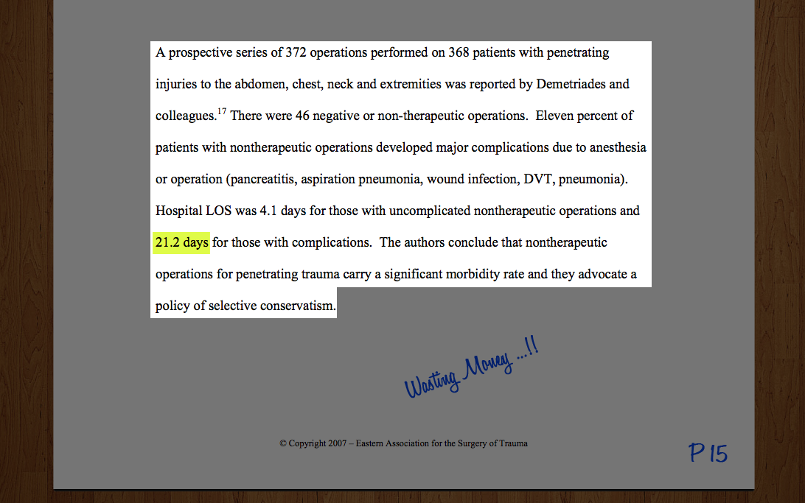

Slide 18

?

Slide 19
Duration of observation
Twenty-four hours of observation is adequate for the vast majority of patients
24hr..??!!

Slide 20
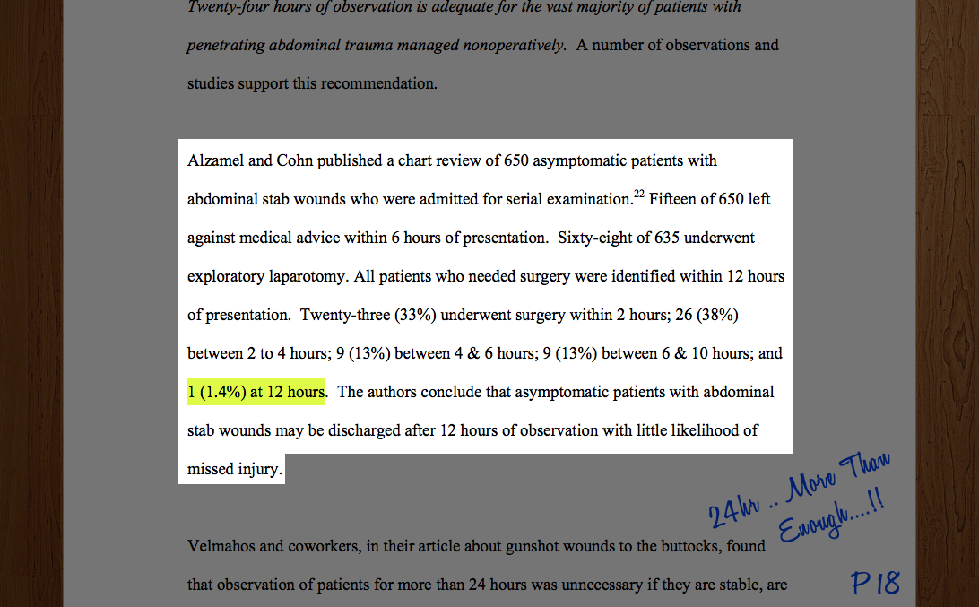

Slide 21


Slide 22
Visceral or omental evisceration
With stable clinical signs and without evidence of peritonitis is a Relative rather than Absolute indication for exploratory laparotomy.

Slide 23
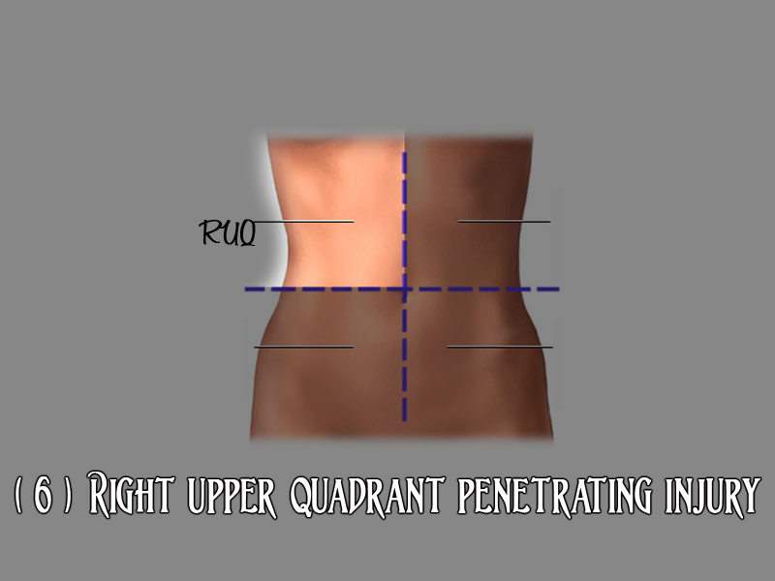

Slide 24
RUQ penetrating injury
With injury to the right lung, right diaphragm, and liver may be safely observed in the presence of
-Stable vital signs,
-Reliable examination and
-Minimal to no abdominal tenderness

Slide 25
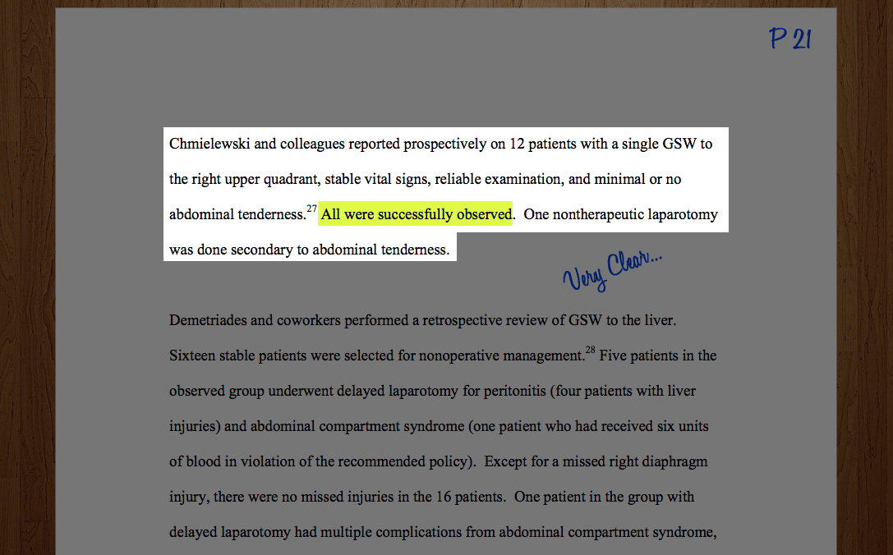

Slide 26
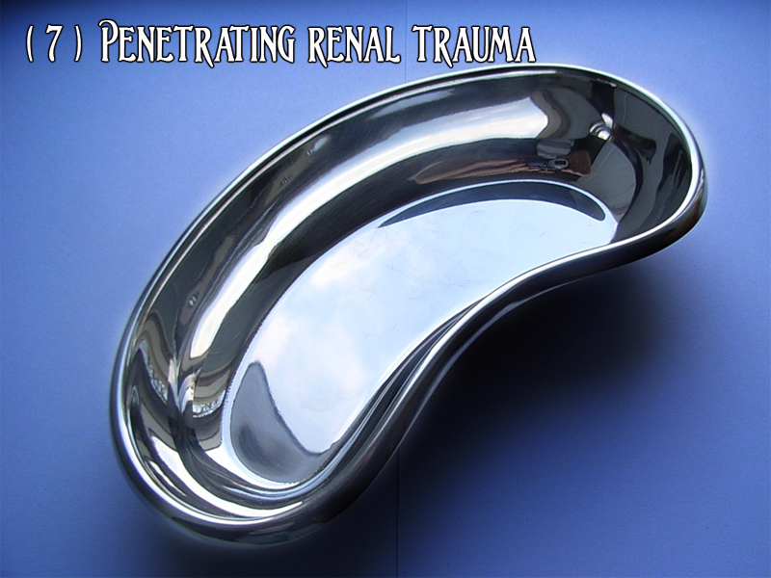

Slide 27
Penetrating renal trauma
When to Operate ??
1-Heamatourea with:
a. Signs of severe blood loss.
b. Associated intra-abdominal laceration.
c. Major abnormality on an intravenous urogram.

Slide 28
Penetrating renal trauma
When to Operate ??
2- CT confirming Hilum Involvement

Slide 29
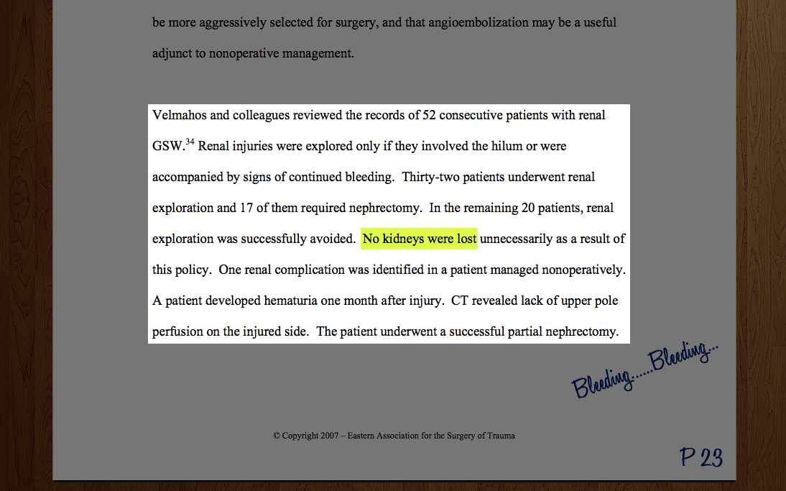

Slide 30
DON’T FORGET
Diaphragm injury → Laparoscopy
FAST → good but not Diagnostic
DPL → No Enough Studies
Local Wound Exploration → Anterior Abdominal Fascia

Slide 31
To take Home MSG
No Signs of Peritonitis
Or Abdominal Tenderness
and Vitally Stable.
Observe for 24h with Serial Physical Exams.
And triple contrast CT.

Slide 32
To take Home MSG
Physical Exam:
Tenderness
Hematuria
Destination
Red Abdomen
Fever
CT

Slide 33
To take Home MSG
If Renal:
Operate only if
1-Heamatourea with:
a. Signs of severe blood loss.
b. Associated intra-abdominal laceration. (CT)
c. Major abnormality on an intravenous urogram.
2-Hilum Involvement (CT)

